Slide 1
Welcome to Cryptography
By Adam Clark, Zach Miller, and Mohamed Mohamed

Slide 2
What is Cryptography
Cryptography is the art and science of keeping information secure through the use of mathematical concepts and techniques.
Cryptography is critical for keeping organizations’ information secure, as information in the wrong hands can result significant financial and reputational damage.
A lot of cryptography involves the use of ciphers and encryption.
A cipher is a method of designing secret or hidden messages, often including algorithms in modern cases.
Encryption is a process of modifying a message or information to prevent unauthorized persons from accessing it.

Slide 3
History of Cryptography (Early stages)
First known use of cryptography in its current form was around 100 BC, where Julius Caesar used a form of encryption to convey secret messages to his army generals posted in the war front. He used a substitution cypher (known today as the Caesar Cipher) where each character of the plain text is substituted by another character to form the ciphertext.
The introduction of encryption keys was first made by Blaise de Vigenere in the 16th century when he created his own cipher where the key itself was repeated multiple times throughout the message.
At the start of the 19th century, Edward Hugh Hebern created the Hebern Rotor machine, an electro-mechanical encryption machine connecting two typewriters through a scrambler.

Slide 4
History of Cryptography (Modern)
Arthur Scherbius created the Enigma machine at the end of World War I and was subsequently used by German Forces during World War II. The machine’s cipher was cracked by Poland and was given to Cryptographers in Britain for them to design a means to obtain a daily key.
Early 1970s - IBM formed a crypto group, designing a cypher for their customers called Lucifer (Later known as DES - Data Encryption Standard) and would later became the national standard block cipher.
1997 - DES becomes broken by brute force attacks and NIST (National Institute of Standards and Technology) put out a proposal for a replacement block cipher. The agency accepted Rijndael (known now as AES - Advanced Encryption Standard) in 2000 after receiving 50 submissions.

Slide 5
Using Cryptography
Involves two actions: encrypted and decrypted, at the most basic levels. A decoder is used during the encryption method to encode plaintext then convert it into encrypted message. On the contrary side, decoding uses the exact same encryption to convert the secret message in to it plain text. And the one that we would be using is a Substitution Cipher.

Slide 6
Symmetric versus Asymmetric Encryption
While symmetric encryption involves the use of one key for both encryption and decryption, asymmetric encryption involves using a pair of keys .
For symmetric encryption the key works with the algorithm to turn plaintext into ciphertext which encrypts the original message.
For asymmetric encryption , a public and a private key are used. While the public key is available to anyone , the private key is kept secret from everyone except the creator of the key. In this case, encryption happens with the public key and decryption occurs with the private key. In this case the recipient provides his/her public key to the sender which is used to encrypt the message. This ensures that only the recipient can decrypt the message with their own private key.

Slide 7
Common Algorithms
(Asymmetric & Symmetric)
Symmetric : Asymmetric:
(DES) Data Encryption Standard (ECDSA) Elliptic Curve Digital Signature Algorithm
(RC4) Rivest Cipher (RSA) Rivest-Shamir-Adleman
Blowfish Diffie-Hellman
(AES) Advanced Encryption Standard (PGP) Pretty Good Privacy

Slide 8
Advantages versus Disadvantages
Advantages: Disadvantages:
Asymmetric
Slower than symmetric Loss of public key won’t compromise the data.
More secure Implementation is more complicated
Only the sender (private key) can decrypt the data.
Symmetric
Simple implementation Could be catastrophic if key is lost
Faster encryption process Security is weaker
Data less likely to be compromised

Slide 9
PAIN Model for Cryptography
The PAIN model represents the core goals of cryptography :
Privacy: keeping data secure from unauthorized parties.
Authentication: Ensures the sender and receivers identities.
Integrity: confirms that the message is sent without alteration.
Non-Repudiation: Confirms that the sender is indeed the one who sent the message

Slide 10
Common Terms:
Plaintext: Data in human-readable form.
Ciphertext: Encrypted plaintext in unreadable form
Decryption: Conversion process of ciphertext to plaintext
Cipher: Method used to perform encryption or decryption
Key: A specific rule used to explain how the plaintext is to be converted to cipher text and vice versa
Caesar Cipher: a cipher that shifts the letters in the alphabet by a specified number either left or right
Substitution Cipher: A method of encryption in which units of plaintext are replaced with ciphertext based on a fixed system
Symmetric Algorithms: The key for both the encryption and the decryption of the hidden message are the same

Slide 11
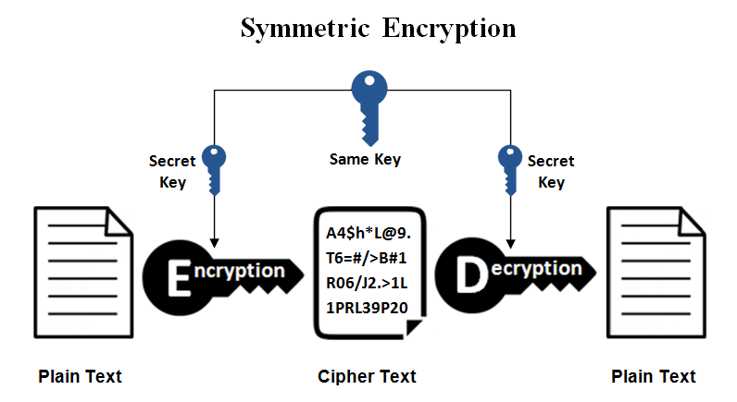
Symmetric Encryption Diagram

Slide 12
SUBSTITUTION CIPHER
Caesar Cipher
A method of encryption (symmetric) in which units of plaintext are replaced with ciphertext based on a fixed system. In the demonstration the “units” are single letters . Caesar Cipher is a method that shifts the alphabet 3 units left whereas A now becomes D . This is shown below:
PLAIN A B C D E F G H I J K L M N O P Q R S T U V W X Y Z
CIPHER X Y Z A B C D E F G H I J K L M N O P Q R S T U V W
PLAINTEXT: “I LOVE CRYPTOGRAPHY.”
CIPHERTEXT: “ F ILSB ZOVMQLDOXMEV.”

Slide 13
Substitution Cipher
Key used to shift the alphabet
Demonstration:
For this demo we will be given a key for the algorithm and then using that key shift the alphabet to encrypt the message .
Message:
Cipher key:
CRYPTO
Encrypted Message:

Slide 14
Substitution Cipher
Key used to shift the alphabet
PLAIN A B C D E F G H I J K L M N O P Q R S T U V W X Y Z
CIPHER C R Y P T O A B D E F G H I J K L M N Q S U V W X Z
PLAINTEXT: “ .”
CIPHERTEXT: “ Btx Lcqmdyf qbcif xjs ojm qtcybdia sn ymxkqjamckbx.”

Slide 15
Original Plain Text message
Message:
“Hey Patrick, thank you for teaching us cryptography.”

Slide 16
Cryptographic Failure
Cryptographic failure is a critical web application security vulnerability that exposes sensitive application data on a weak or compromised cryptographic algorithm. This can include passwords, credit card information, patient health records, secret business information, email addresses or numerous other personal user information.

Slide 17
Common security issues that lead to cryptography failures
Transmitting secret data in plaintext form
Using older (less secure) algorithms
Improper cryptographic key management
Lack of randomness for cryptographic functions
Missing encryption

Slide 18
Mitigation for Cryptography
Strong regulation safeguards to avoid key abuse/reuse.
Rotating keys automatically.
Automated deployment of secured keys.
Disable caching for responses with sensitive data.
Using updated and established cryptographic functions, algorithms and protocols.
Discard unused data.

Slide 19
RESOURCES
https://umn.bootcampcontent.com/University-of-Minnesota-Boot-Camp/UofM-VIRT-CYBER-PT-06-2022-U-LOLC
https://www.edureka.co/blog/what-is-cryptography/
History of Cryptography - GeeksforGeeks
https://www.encryptionconsulting.com/education-center/symmetric-vs-asymmetric-encryption/
https://crashtest-security.com/owasp-cryptographic-failures/
https://www.ssl2buy.com/wiki/symmetric-vs-asymmetric-encryption-what-are-differences

